Slide 1

Insights from Airbnb Analysis from Pre-COVID Period
Notes:
Objective

Slide 2
AGENDA
Objective
Background
Key Findings
Appendix:
Data sources
Data methodology
Data model assumptions
Notes:
Objective

Slide 3
OBJECTIVE
Improve our strategies to revive the business in the post-COVID period.
Understand key insights from Airbnb NYC business in pre-COVID period.
Estimate customer preferences for the post-COVID period travel.
Notes:
Objective

Slide 4
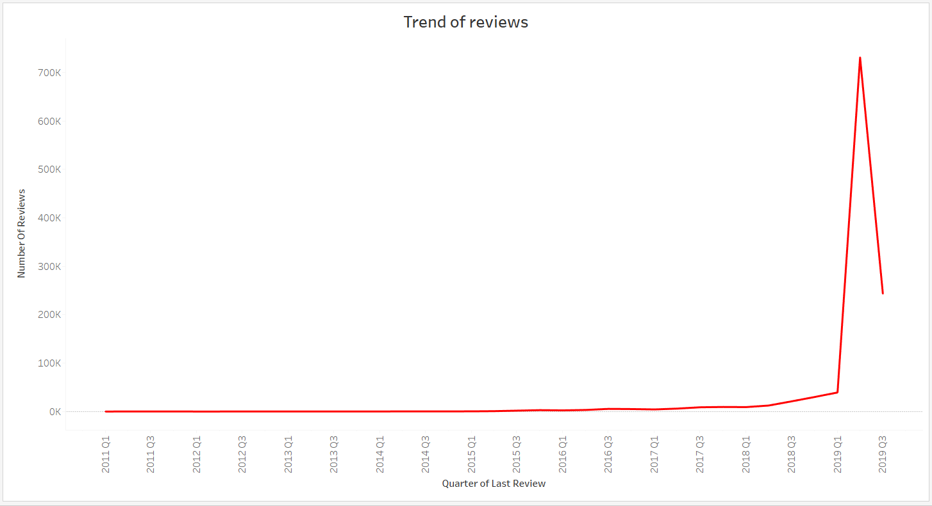
BACKGROUND
The COVID-19 pandemic affected Airbnb business due to travel restrictions.
The revenue took the largest hit in NYC in the Q2 and Q3 of 2019.
Now that the travel restrictions are lifted, the business should be operated to recover the loss.
Notes:
Objective

Slide 5
Objective of the Analysis of the Airbnb NYC Data
Customer preferences and ratings of different hosts of Airbnb in were analyzed.
Data was analyzed to derive key insights from the Pre-COVID period.
Insights will be used to take decisions for the NYC Airbnb business for travel in post-COVID period.
Notes:
Objective

Slide 6
Data Preparation and Cleaning
Missing values in few columns were treated and simple statistical analysis of data was performed using Python.
Correlation of different features in the dataset were evaluated and no significant relationships were found among the features using heat map and pair plots.
Visuals were derived using the Tableau tool to understand key inferences from the analysis.
Notes:
Objective

Slide 7
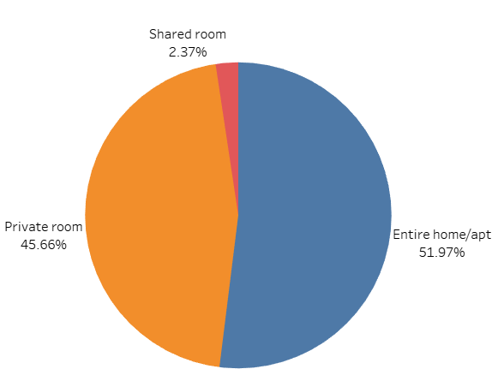
Customer preferences for room-type
Only 2.37% of the room type belong to shared room category, and the rest is shared by Private room and Entire home/apt.
Room types ‘Entire home/apt’ and ‘Private room’ account for a major portion of the listed properties(97.63%) in NYC in pre-COVID time and this may remain prevail in the post COVID time as well.
Customers would prefer to isolate themselves; hence shared rooms can be converted to ‘Private room’ to increase footfall and revenue.

Slide 8
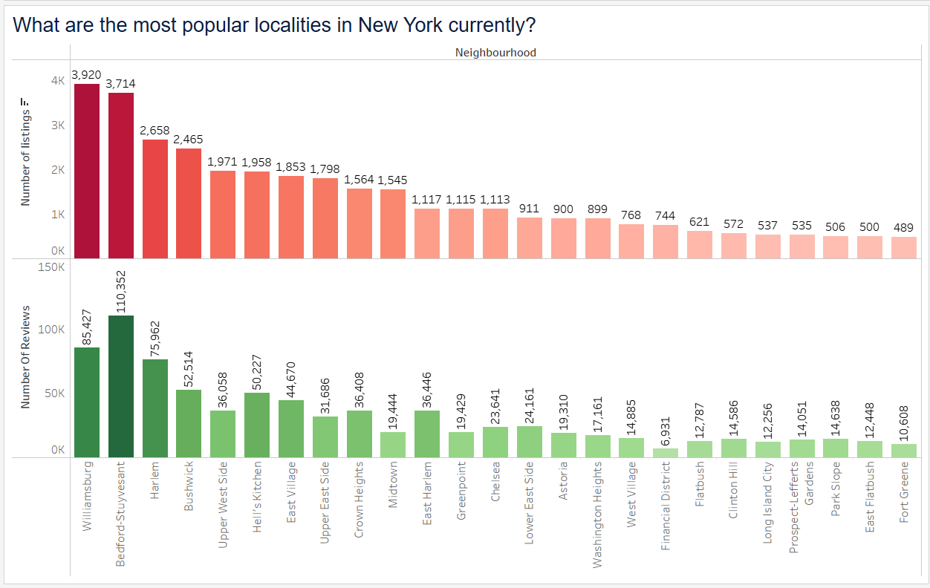
Customer preferences of localities in NYC
Williamsburg, Bedford-Stuyvesant, and Harlem have the highest number of reviews and listings in NYC neighborhoods.
Number of listings are positively skewed but this trend is not maintained with respect to number of reviews.
Williamsburg, Upper West Side, Upper East Side, Midtown and Financial district have fewer reviews in comparison with number of listings.

Slide 9
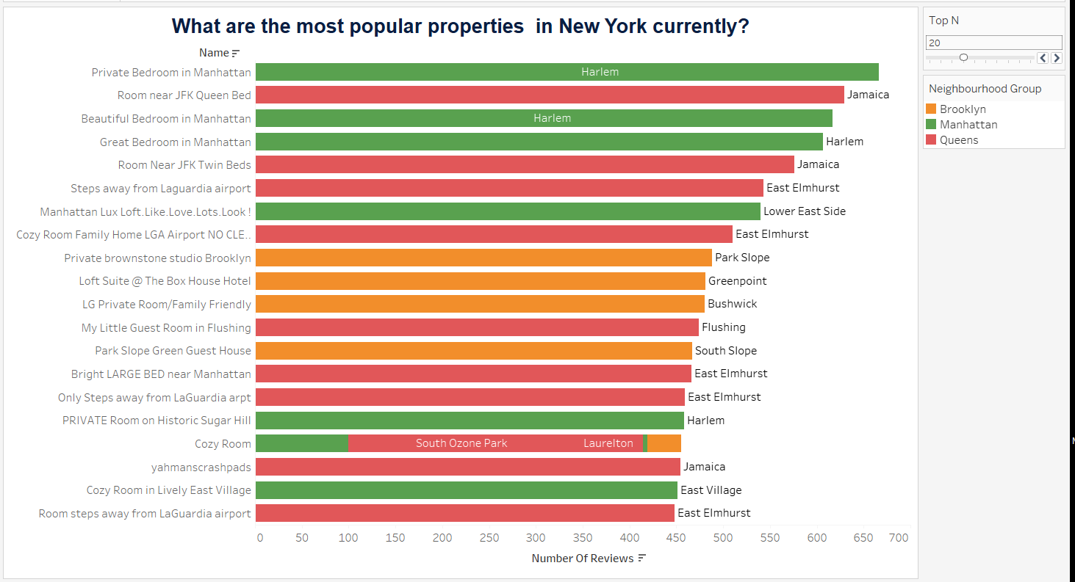
Customer preferences of properties in NYC
There are few properties with the same name across neighborhoods.
Although, the number of listings in Queens is lower, properties feature a lot in the top N results with respect to the highest number of ratings. This may be attributed also to the fact that fewer listings are available in Queens and hence the listings have higher number of ratings available.

Slide 10
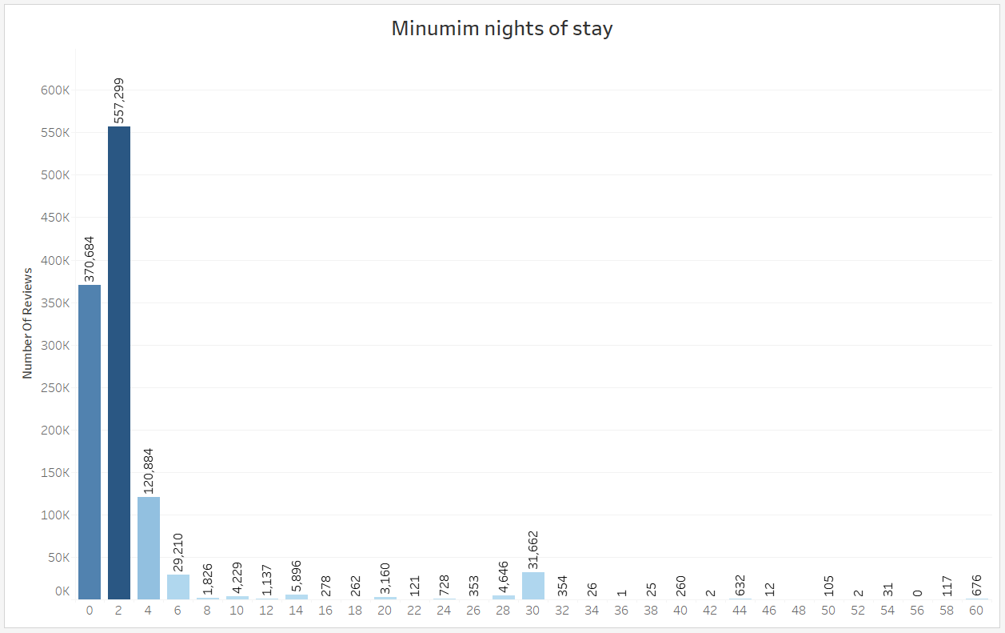
Customer preferences of properties in NYC
Customers prefer $0 to $500 per night price points as observed from the number of reviews, hence higher bookings are observed for such listings.
Customers prefer 1-10 days of minimum nights per stay. There is spike for 30, 60 and 90 days during pre-COVID time.
Properties with a higher number of minimum nights of stay and higher price have low reviews.
Due to ongoing pandemic, customers may prefer to book properties for 30, 60 or 90 days to prevent frequent travelling.

Slide 11
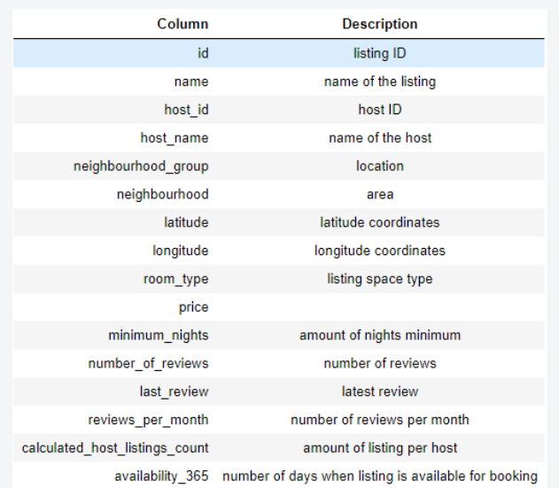
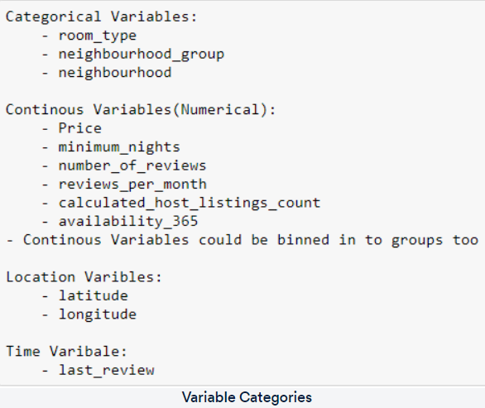
APPENDIX – DATA SOURCES

Slide 12
APPENDIX – DATA METHODOLOGY
Performed analysis on Airbnb dataset using Python and Tableau.
Data Importing
Data Quality Check
Data Cleaning:
Missing Value Treatment
Data Imputation
Data Analysis:
Bivariate Analysis using Heatmap and Pairplotame to a CSV file
Exported cleaned dataframe in csv file
Data Visualization on cleaned data set

Slide 13
APPENDIX - DATA ASSUMPTIONS
We assumed the data prior to the COVID – 19 period was achieving the desired revenue.
We assumed unpopular properties are the ones that have not been reviewed even once.
We assumed the company does not want to expand yet to new territories in NYC.
Company’s strategies are decided considering the travel will increased in the post COVID period.
Notes:
Objective

